Slide 1

A.I. tips and guides for devs
Using Copilot as a development tool

Slide 2
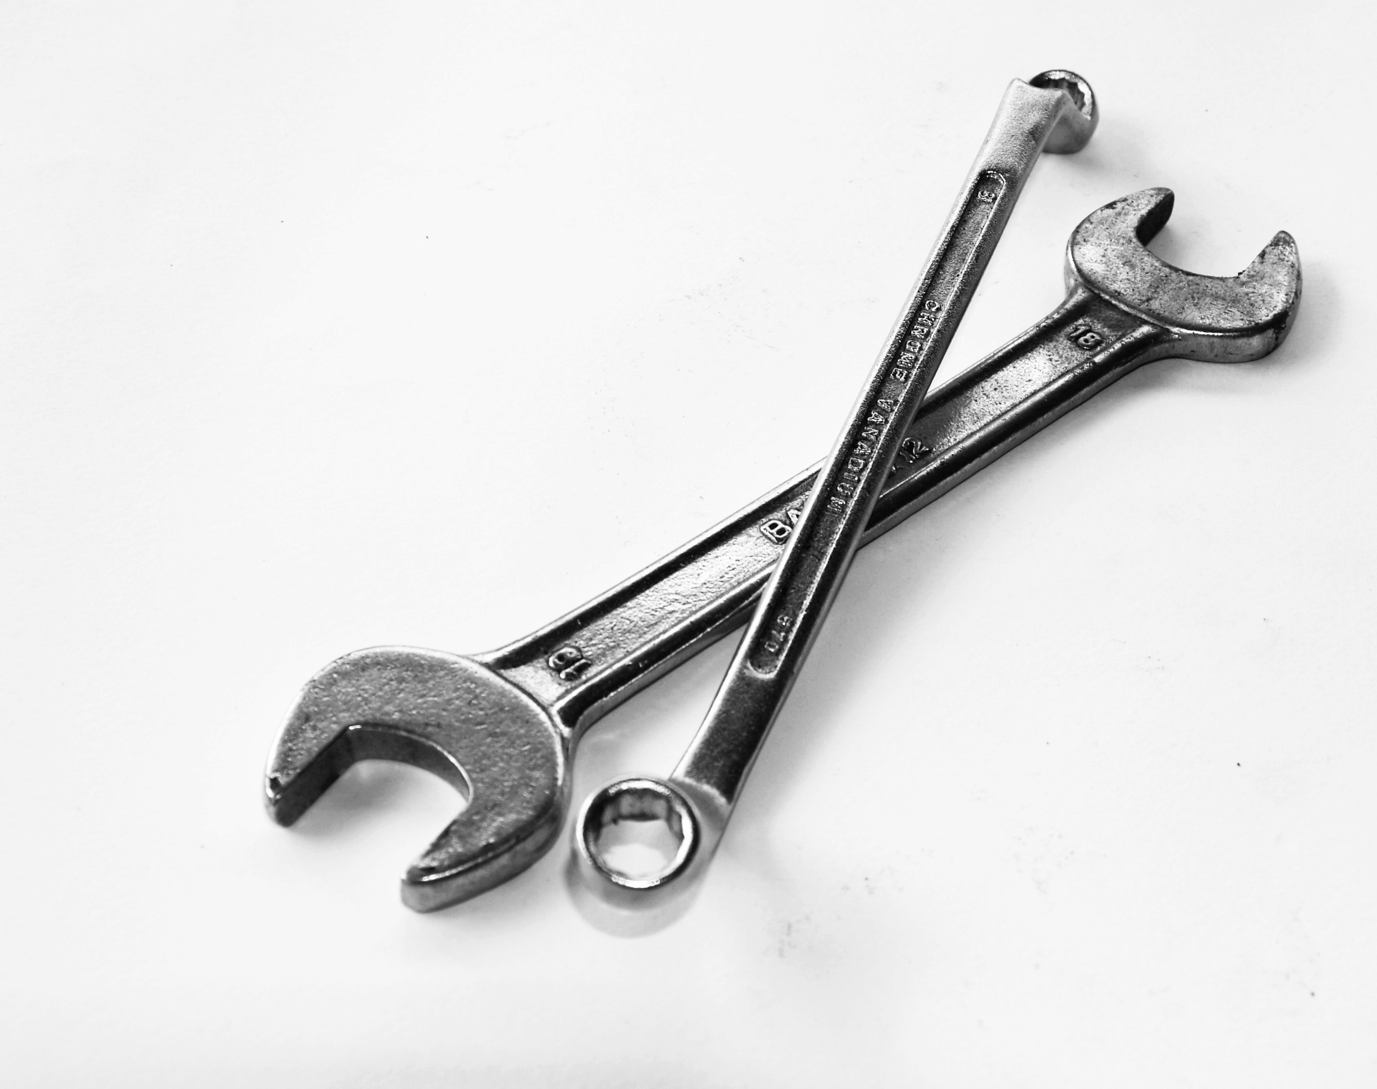
Copilot: Tool to improve your productivity

Slide 3

Non-deterministic

Slide 4

Faulty
Incomplete
Incorrect
Incoherent
Esta foto de Autor desconocido está bajo licencia CC BY-SA-NC

Slide 5

Road to perfection
High-level goal
Simple and specific steps
Give an example… or two

Slide 6

Prompt engineering… or art?

Slide 7

Tips
Experiment, refine, and educate
Open tabs to give context
Use best coding practices and standards
Make Copilot impersonate a role

Slide 8
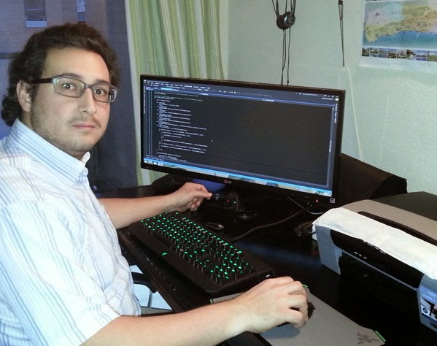
It’s your responsibility to review the code.
Esta foto de Autor desconocido está bajo licencia CC BY-NC-ND

Slide 9

Programming is writing a process with detail in an unambiguous language.

Slide 10

Extra bonus
Reduce the fear of mistakes
Makes learning easier
Improves communication skills
Helps with documentation

Slide 11

Thanks
By Alberto Basalo and Copilot

